Slide 1
Image Segmentation
Progress Report
Bishal

Slide 2

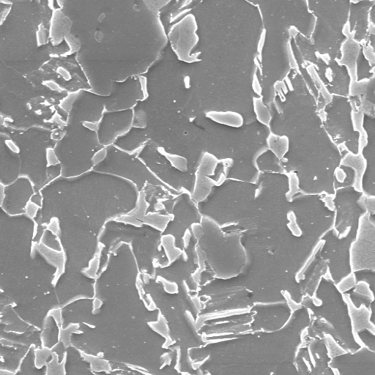
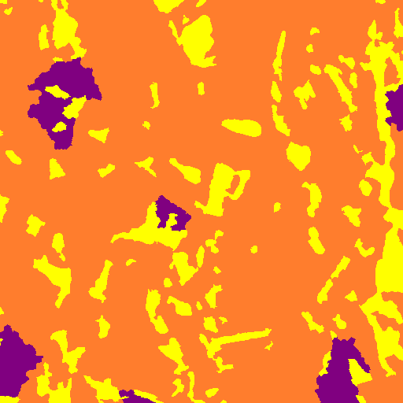

Model Output
Input Test Image
Input Label Image
Output Test Image
Validation mIOU → 0.48173709331297165
Validation Acc → 97.44
Dice Coefficient(Non-Alias) → 0.9882

Slide 3
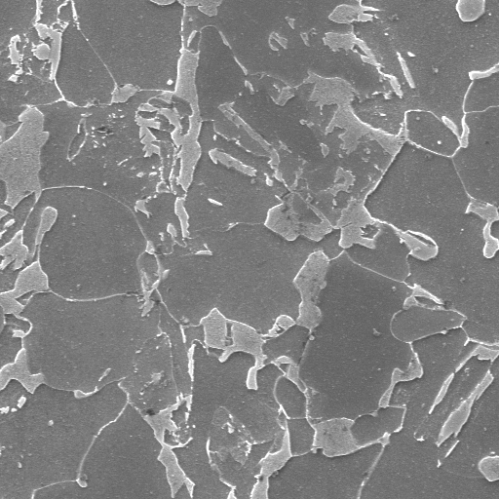
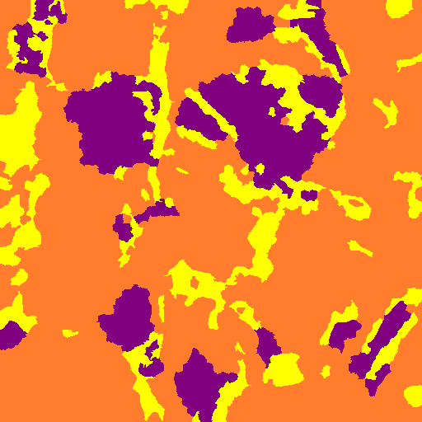
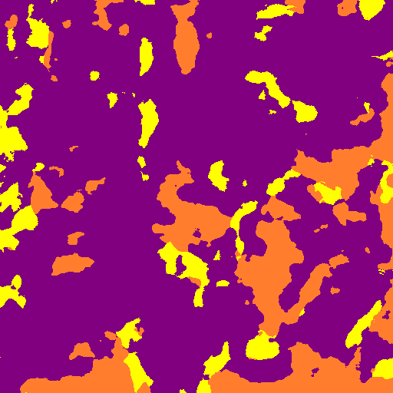
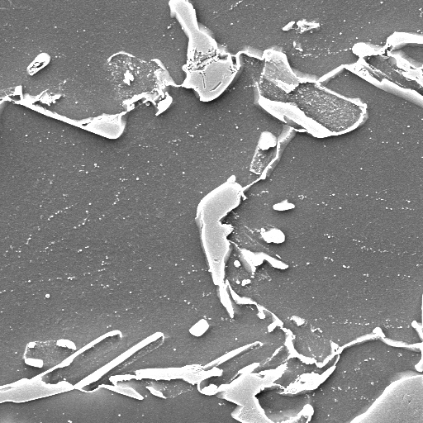
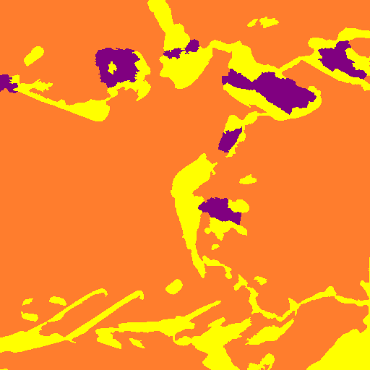
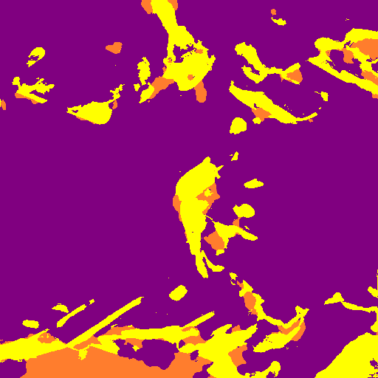
With Magnified
← x3000 Magnification
Dice Coefficient → 0.411
Dice Coefficient → 0.2209
x5000 Magnification →

Slide 4
Observation
x3000 Magnification
Even with magnification, the model predicts the bright part of the images (into yellow) properly.
But as the distinction between the gray areas for orange and purple is less, the model does not generalize well.
x5000 Magnification

